Slide 1


Advancing the Space Race through Data Science
Pascal F. Meier
23.Jun.2024

Slide 2


1. Project Outline
Executive Summary
Introduction
Methodology
Results
Conclusion
Appendix

Slide 3
2. Executive Summary
Public available data sources from SpaceX API and SpaceX Wikipedia page are used for data wrangling.
Rocket landings are sorted in an extra column “class” based on their landing outcome.
Using SQL, visualization, Folium map and dashboards to explore the data.
Normalizing and standardized the data. Applying GridSearchCV to find the best parameters for machine learning models.
Accuracy score of all models are used for visualization.
While four machine learning models were used (Logistic Regression, Support Vector Machine, Decision Tree Classifier, and K Nearest Neighbors), all of them produced similar results, predicting a successful landing with an accuracy rate of ~83.33%.
For a better prediction and model determination of future flights and landings, more data is necessary.

Slide 4

3. Introduction
Commercial Space Age is now!
The governmental monopoly for space flights has been taken over by the private sector. The funding of space flights is no longer solemly in the hand of tax payers but it is business that capitalize on the opportunity of sending rockets to space.
Reducing the price of a space flight brings an advantage to every company. Due to the ability of recover and reuse parts of the rocket, SpaceX has the best pricing model (US $62 million vs. US $165 million by there nearest competitors).
SpaceY wants to compete with SpaceX on the bidding of future missions. How can the use of data science advance SpaceY to predict the successful recovery of Stage1 of rockets and therefore win the bid for future missions.
Y-Wing: https://overmental.com/content/star-wars-canon-catch-up-what-are-y-wings-40599

Slide 5
4. Methodology
Data collection methodology:
Combined data from SpaceX public API and SpaceX Wikipedia page
Perform data wrangling
Classifying true landings as successful and unsuccessful otherwise
Perform exploratory data analysis (EDA) using visualization and SQL
Perform interactive visual analytics using Folium and Plotly Dash
Perform predictive analysis using classification models
Tuned models using GridSearchCV

Slide 6
5. Data Collection
Through an API request from SpaceX public database, data was collected. Furthermore web scrapping from SpaceX Wikipedia entry was used. Both database were combined.
Both processes are visualized in Flow-charts in the following two slides.
Space X API Database containing the following informations: FlightNumber, Date, BoosterVersion, PayloadMass, Orbit, LaunchSite, Outcome, Flights, GridFins, Reused, Legs, LandingPad, Block, ReusedCount, Serial, Longitude, Latitude
Webscraping from Wikipedia Entry containing the following informations : Flight No., Launch site, Payload, PayloadMass, Orbit, Customer, Launch outcome, Version Booster, Booster landing, Date, Time

Slide 7
6. Data Collection – SpaceX API
GitHub URL Reference: https://github.com/Mr-Minion/IBM_Data_Science_Professional_Certificate/blob/main/Applied_Data_Science_Capstone/Module1/Data_Collection_API.ipynb
Space X API
Request
Sorting for dictionary relevant data
Filter data for Falcon 9 launches
Creation of
.JSON file
Normalize .JSON file to df data
Cast dictionary to df
Imputate missing PayloadMass values with mean

Slide 8
7. Data Collection - WebScraping from Wikipedia
GitHub URL Reference: https://github.com/Mr-Minion/IBM_Data_Science_Professional_Certificate/blob/main/Applied_Data_Science_Capstone/Module1/Data_Collection_Web_Scraping.ipynb
Wikipedia HTML Request
Creation of dictionary
Iterate through table cells to extract data to dictionary
BeautifulSoup
html5lib Parser
Find launch info via html table
Cast dictionary to DataFrame

Slide 9
8. Data Wrangling
GitHub URL Reference:
https://github.com/Mr-Minion/IBM_Data_Science_Professional_Certificate/blob/main/Applied_Data_Science_Capstone/Module1/Data_wrangling.ipynb
The Outcome column has two components: “Mission Outcome” and “Landing Location”.
In order to investigate the landing outcome/class, an additional column “class” was create.
For each mission, if the “Mission Outcome” was registered as “True”, a value “1” was added to ”class”. For failures a value “0” was added to the ”class”.
Value Mapping of landing outcomes:
“True ASDS”, “True RTLS”, “True Ocean” were assigned a landing class value of ”1”
“None None”, “False ASDS”, “None ASDS”, “False Ocean”, “False RTLS” were assigned a landing class value of ”0”.

Slide 10
9. EDA with Data Visualization
GitHub URL Reference:
https://github.com/Mr-Minion/IBM_Data_Science_Professional_Certificate/blob/main/Applied_Data_Science_Capstone/Module2/EDA_with_Visualization.ipynb
Visualizing data:
To visualize the data, the following charts were plotted to compare the relationship between variables:
Scatter plots, line charts, bar plots
By this means it could be decided whether a relationship exist between Flight Number vs. Payload Mass, Flight Number vs. Launch Site, Payload Mass vs. Launch Site, Orbit vs. Success Rate, Flight Number vs. Orbit, Payload vs Orbit, and Success Yearly Trend. Such relationships can be used in training the machine learning model.

Slide 11
10. EDA with SQL
GitHub URL Reference: https://github.com/Mr-Minion/IBM_Data_Science_Professional_Certificate/blob/main/Applied_Data_Science_Capstone/Module2/EDA_with_SQL.ipynb
Download dataset and store it as database table in IBM DB2 Database.
SQL Python integration is used for queries.
Queries are a helpful too to better understand the dataset.
The queried information contain launch site names, mission outcomes, various pay load sizes of customers and booster versions, and landing outcomes.

Slide 12
11. Build an Interactive Map with Folium
GitHub URL Reference: https://github.com/Mr-Minion/IBM_Data_Science_Professional_Certificate/blob/main/Applied_Data_Science_Capstone/Module3/Interactive_Visual_Analytics_with_Folium.ipynb
Folium maps display launch sites, successful and unsuccessful landings, and proximity to key locations such as railways, highways, coasts, and cities. This helps understand the strategic placement of launch sites and visualizes the success rate of landings based on location.

Slide 13
12. Build a Dashboard with Plotly Dash
GitHub URL Reference: https://github.com/Mr-Minion/IBM_Data_Science_Professional_Certificate/blob/main/Applied_Data_Science_Capstone/Module3/spacex_dash_app.py
Creation of a dashboard containing a pie chart and a scatter plot.
In the pie chart, a selection of the distribution for successful landings across all landing sites can be made. Additionally individual launch sites can be selected to visualize their success rate.
The scatter plot has two inputs: Sites (all or individual) and PayloadMass on a slider between 0 and 10000 kg. This can help to visualize the success rate across launch sites, payload mass, as well as booster version category.

Slide 14
13. Predictive Analysis (Classification)
GitHub URL Reference: https://github.com/Mr-Minion/IBM_Data_Science_Professional_Certificate/blob/main/Applied_Data_Science_Capstone/Module4/Machine_Learning_Prediction.ipynb
Split label column ‘Class’ from dataset
GridSearchCV(cv=10) to find optimal parameters
Use GridSearchCV on LogReg, SVM, Decision Tree, KNN Model
Barplot to compare scores of models
Fit and transform features by StandardScaler
Split data for train and test part
Score models on split test sets
Confusion matrix for all models

Slide 15

14. Results
Exploratory data analysis results
Interactive analytics demo in screenshots
Predictive analysis results

Slide 16

Section 2

Slide 17
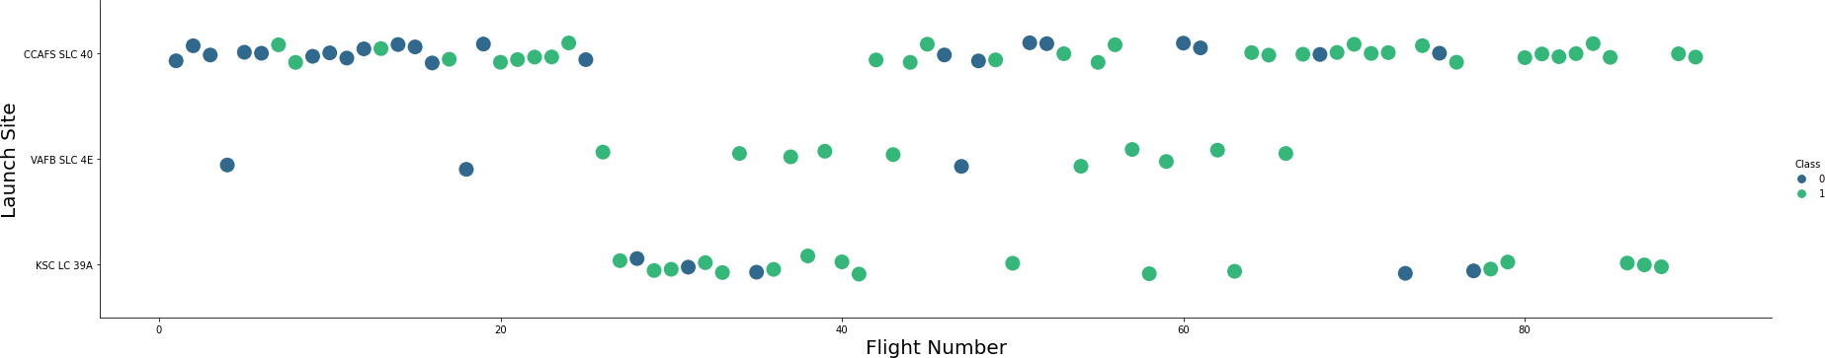
15. Flight Number vs. Launch Site
Flight Number per Launch Site:
Green indicates successful launch; blue indicates unsuccessful launch
An increased success rate over time (by increased Flight Number) is shown.
A breakthrough is shown at around flight 20, with a significantly increased success rate.
CCAFS SLC40 has the most launches with a high success rate

Slide 18
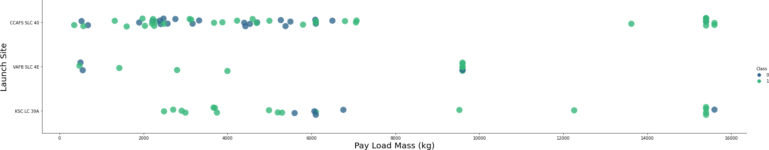
16. Payload vs. Launch Site
Payload per Launch Site:
Green indicates successful launch; blue indicates unsuccessful launch
Successful launches of different payload differ for different launch sites.
Unsuccessful launches occur in the range of ~500kg to 6500 kg payload mass.

Slide 19
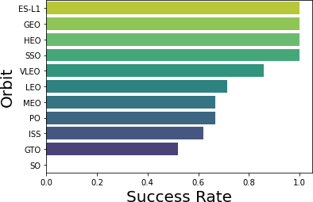
17. Success Rate vs. Orbit Type
100% success rate are shown for ES-L1 (1x), GEO (1x), HEO (1x), and SSO (5x) (sample sizes in parenthesis).
90% success rate is shown for VLEO (14x).
GTO (27) has the around 50% success rate but largest sample
SO (1x) has 0% success rate.
This analysis shows that the dataset is fairly small for each orbit type.

Slide 20
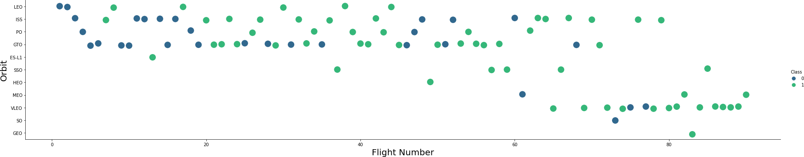
18. Flight Number vs. Orbit Type
Flight Number per Orbit Type:
Green indicates successful launch; blue indicates unsuccessful launch
Orbits that the rockets are launched to diversify over flight numbers
The successful outcome of launches correlate with the flight numbers

Slide 21
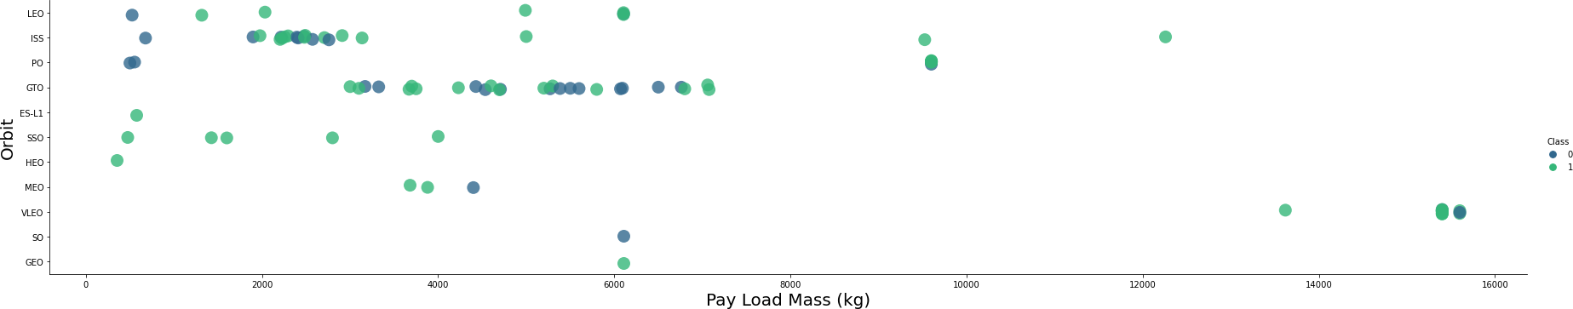
19. Payload vs. Orbit Type
Payload per Orbit Type:
Green indicates successful launch; blue indicates unsuccessful launch
The payload mass has a correlation with the orbit type based on this chart
The payload for LEO, SSO and MEO have a successful launch with relatively low payload mass.
The payload for VLEO is successful with high payload mass.

Slide 22
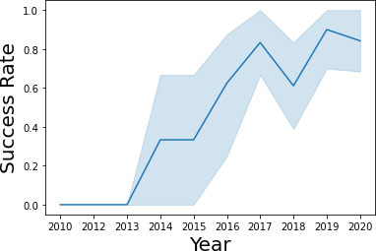
20. Launch Success Yearly Trend
95% confidence interval as light blue shading
Successful launches increase over time since 2013 to 2019 with a slight dip in 2018.
In recent years the success rate dropped slightly to around 80%

Slide 23
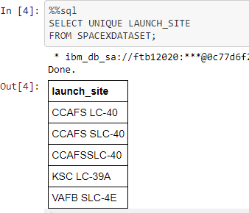
21. All Launch Site Names
Name query for unique launch site from database
The three launch sites CCAFS LC-40, CCAFS SLC-40 and CCAFSSLC-40 look the same and most likely represented the same launch site. This can be due to data entry error and requires data manipulation.
Therefore we assume that only 3 unique launch_site values exist: CCAFS SLC-40, KSC LC-39A, VAFB SLC-4E

Slide 24
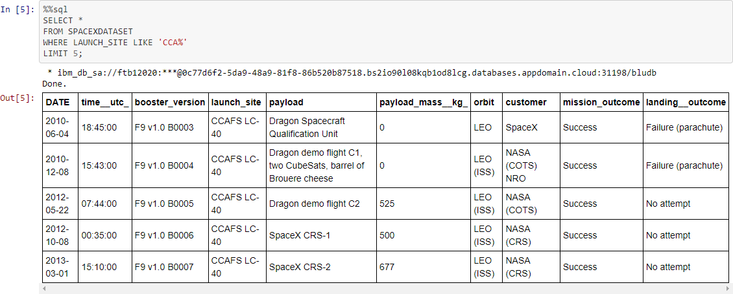
22. Launch Site Names Begin with 'CCA'
The first five entries in the database with the launch_site name beginning with CCA are shown.

Slide 25
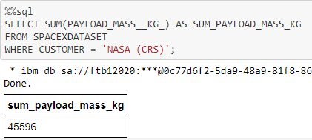
23. Total Payload Mass
The query sums the total payload mass in kg as sum_payload_mass_kg for the filtered by the customer “NASA”.
NASA (CRS) are resupply missions (Commercial Resupply Services)to the International Space Station (ISS).

Slide 26
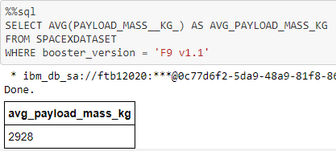
24. Average Payload Mass by F9 v1.1
The query calculates the average payload mass carried by booster version F9 v1.1
The average payload mass is 2928kg and on the lower end of he payload mass range.

Slide 27
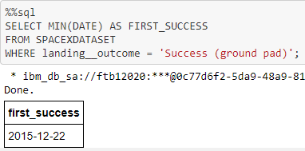
25. First Successful Ground Landing Date
To determine the first successful landing outcome on a ground pad this query was used.
The resulting date of the first successful landing outcome on ground pad was on 22.Dec.2015.

Slide 28
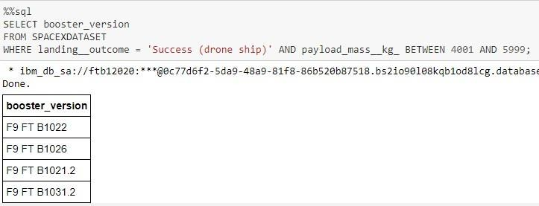
26. Successful Drone Ship Landing with Payload between 4000 and 6000
This query was used to determine the booster types that resulted in a successful landing on a drone ship, with a lift-off payload between 4000 and 6000 kg.
The following booster versions were used: F9 FT B1022, F9 FT B1026, F9 FT B1021.2, F9 FT B1031.2

Slide 29
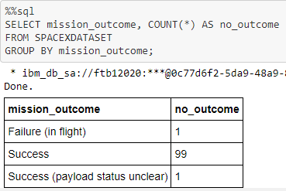
27. Total Number of Successful and Failure Mission Outcomes
This query is used to return each mission outcomes.
The total number of successful and failure mission outcomes are listed.

Slide 30
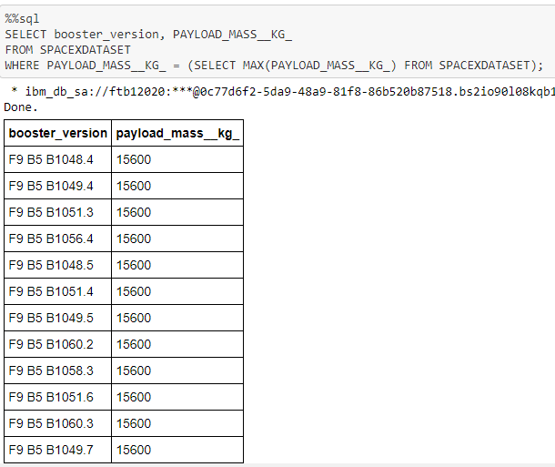
28. Boosters Carried Maximum Payload
This query is used to return booster versions with the highest payload mass of 15600kg.
These booster versions look like to be of a Falcon 9 type, indicated by the F9 B5 B10XX.X numbering.
A correlation between the payload mass and booster version is therefore most likely.

Slide 31
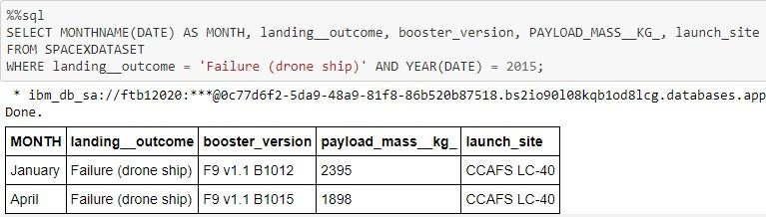
29. 2015 Launch Records
This query lists the failed landing_outcomes on drone ships, including their their booster versions, and launch site names for the year 2015.

Slide 32
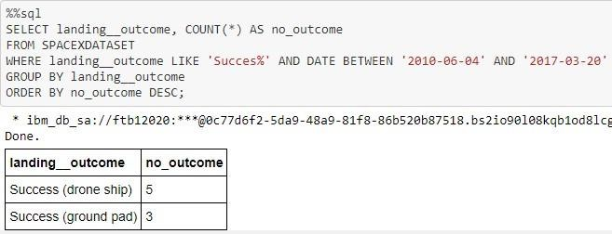
30. Rank Landing Outcomes Between 2010-06-04 and 2017-03-20
This query ranks the landing outcome by drone ship and ground pad between the 04. Jul.2010 and 20.Mar.2017 in a descending order.

Slide 33

Section 3

Slide 34

31. Locations of the launch sites in the USA
In the left map, launch sites (in orange) are shown across the USA.
In the right map, a closer look was done to the launch sites in Florida.
Multiple launch sites exist in close proximity.

Slide 35

32. Color Coded Markercluster of launch site
Interactive MarkerClusters in the Folium map was created. Each marker will display a successful landing (green icon) and failed landing (red icon).
VAFB SLC-4E is shown here with 4 successful landings and 6 failed landings.

Slide 36

Section 4

Slide 37


33. Successful launches at different launch sites
The distribution of successful landings at different landing sites is shown in a pie chart. Percentage values are indicating the success at the different sites compared to each other.
CCAFS LC-40 and CCAFS SLC-40 are the same launch sites, resulting in a total success rate of 41.7%.
The majority of successful landings where done at CCAFS and KSC LC-39A with 41.7%
However the overall data size is small.

Slide 38

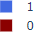
34. Highest success rate at launch site
For KSC LC-39A the success rate is the highest with 10 successful landings and 3 failed landings, resulting in a 76.9% success rate.
KSC LC-39A Success Rate (blue color)

Slide 39
<Dashboard Screenshot 3>
Replace <Dashboard screenshot 3> title with an appropriate title
Show screenshots of Payload vs. Launch Outcome scatter plot for all sites, with different payload selected in the range slider
Explain the important elements and findings on the screenshot, such as which payload range or booster version have the largest success rate, etc.

Slide 40

Section 5

Slide 41

Classification Accuracy
All built classification models are compared in a bar chart.
For all models the accuracy on the test set is at the same value of 83.33% accuracy.
Test samples are however low with a sample size of 18.
The small test set can therefore cause a large variance in accuracy results in repeated runs.
To determine the best model with higher accuracy, more data is required.

Slide 42

Confusion Matrix
Confusion Matrix visualize the landing prediction
The Confusion Matrix is the same for all calculated models.
12 successful landings were predicted when the true label was a successful landing.
3 unsuccessful landings were predicted when the true label was unsuccessful landing.
3 successful landings were predicted when the true label was unsuccessful landings (false positives).
All models overpredicted a successful landing.

Slide 43
Conclusions
The task of this Capstone Project was to develop a machine learning model for SpaceY who wants to bid against SpaceX.
With our models we predict when and where a Stage 1 of the rocket will successfully land and therefore save ~$100 million USD.
Public available data from SpaceX API and webscraping from the SpaceX Wikipedia page was used.
Data labels were created and the data was stored into a DB2 SQL database.
The creation of a dashboard helped to visualize the data.
A machine learning model was created with an accuracy of 83%.
This models is available to the board of SpaceY to predict with relatively high accuracy whether a launch will have a successful Stage 1 landing, even before the launch.
For more accurate predictions, more data is required to improve the accuracy of the machine learning model.

Slide 44
Appendix
GitHub repository URL: https://github.com/Mr-Minion/IBM_Data_Science_Professional_Certificate/tree/main/Applied_Data_Science_Capstone
Special Thanks to all the instructors and the Funding bodies

Slide 45


